Slide 1


CO-CURRICULAR
CLUBS
Beyond the Classroom: Shaping Skills that Last a Lifetime

Slide 2


Co- Curricular Clubs
TOTAL NUMBER OF CO-CURRICULAR CLUBS | 15
NUMBER OF STUDENT MEMBERS | 165
NUMBER OF FACULTY COORDINATORS | 15
Co-curricular Club Activity Incharge | Prof. Rakesh Chandrashekar Associate Head Students Welfare
https://newhorizoncollegeofengineering.in/students-clubs/

Slide 3


About Co-Curricular Clubs
Joining clubs empowers students to build meaningful connections, expand their networks, and develop essential skills that extend beyond academics.
Through active participation, students cultivate leadership, teamwork, and creativity while maintaining a healthy balance between personal growth and social life.
3

Slide 4


Purpose of Joining Clubs
Networking & Collaboration
Leadership Excellence
Social Engagement
Organizational & Management Skills
Professional Growth
Enriching College Culture
Personal Development
4

Slide 5





NHCE Co-Curricular Clubs
Emsys Club
Innovation Club
Evolve.AI Club
Business And information Technology Club
Cyber Security and Ethical Hacking Club
5

Slide 6





NHCE Co-Curricular Clubs
Tech Forge Club
Robohorizon Club
Green Energy Club
Aerobots Club
Data Analytics Club
6

Slide 7





NHCE Co-Curricular Clubs
Stem Club
Mobile App development Club
Healthxcel Club
ED and Startup Club
Foss Club
7

Slide 8

Emsys Club
Project Expo
Purpose: Organized by EMSYS NEX GEN Club to showcase student innovations and creative ideas.
Participation: Students presented their work to judges and visitors, encouraging interaction and knowledge exchange
Project Demo: Each team was given 3–5 minutes to clearly and effectively present their project.
Professional Conduct: Participants ensured clean displays and showed professionalism throughout.
10

Slide 9

Innovation Club
Tech Olympics
Organized by the INNOVATION Club, Tech Olympics was a beginner-friendly, software-based event promoting teamwork and coding skills.
Round 1 – Software Sprint: Teams built a functional and visually appealing website on a given theme within 20 minutes.
Round 2 – Code Hurdles: Participants debugged given codes under time pressure to test accuracy and speed.
The event promoted creativity and teamwork, rewarding the top two teams.
11

Slide 10

Evolve.Ai Club
Intellect Ascent
Overview: Intellect Ascent is an electrifying event designed to challenge mental agility, creativity, and teamwork.
Activities: Participants solved puzzles and challenges testing their problem-solving skills.
Objective: The event fostered quick thinking, innovation, and teamwork.
Highlight: A platform for students to showcase intellect, challenge limits, and excel.
12

Slide 11

BIT Club
The Great Club Debate
Overview: A debate event on trending tech and business topics showcasing communication skills.
Format: Competitors advance through two rounds, with preparation time to structure their points.
Judging Criteria: Winners are selected based on clarity, relevance, impact, and audience engagement.
13

Slide 12

Cyber Security and Ethical Hacking
The Encrypted Lockdown
Overview: MindMaze Challenge is a puzzle-solving event testing participants’ logic, coding, and analytical skills.
Activities: Challenges include tech riddles, cipher decoding, coding tasks, and problem-solving exercises.
The event encourages creativity, critical thinking, and strategic reasoning among all participants.
14

Slide 13

Data Analytics & Techforge club
Data Dive
Overview: Data Dive, organized by TECH FORGE Club & Data Analytics Club, challenges students to solve time-sensitive, analytical problems.
Objective: The event promotes quick thinking, alternative approaches, and problem-solving skills.
Collaboration: Participants are encouraged to work with peers and share reasoning behind their solutions.
15

Slide 14
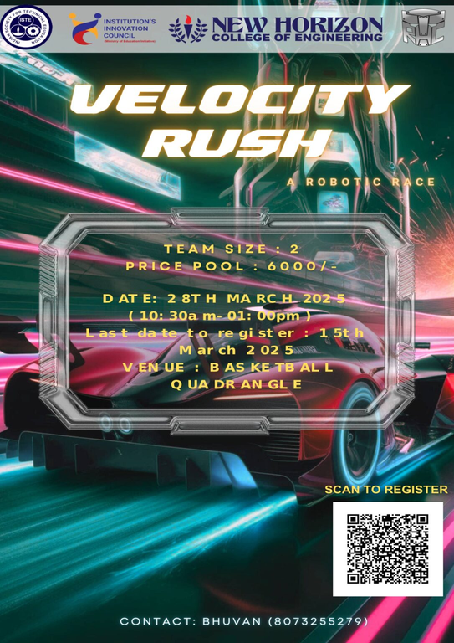
Robohorizon Club
Velocity Rush
Objective: Teams will build a wireless remote-controlled EV car capable of racing on rugged and off-road tracks.
Track: 120 m long, 80–90 cm wide, with ramps, tire turns, and dynamic obstacles.
Checkpoints: There are four checkpoints, with teams being disqualified if they restart at any checkpoint three times.
Challenge: The event tests engineering skills, control precision, and adaptability on a challenging and ever-changing track.
16

Slide 15
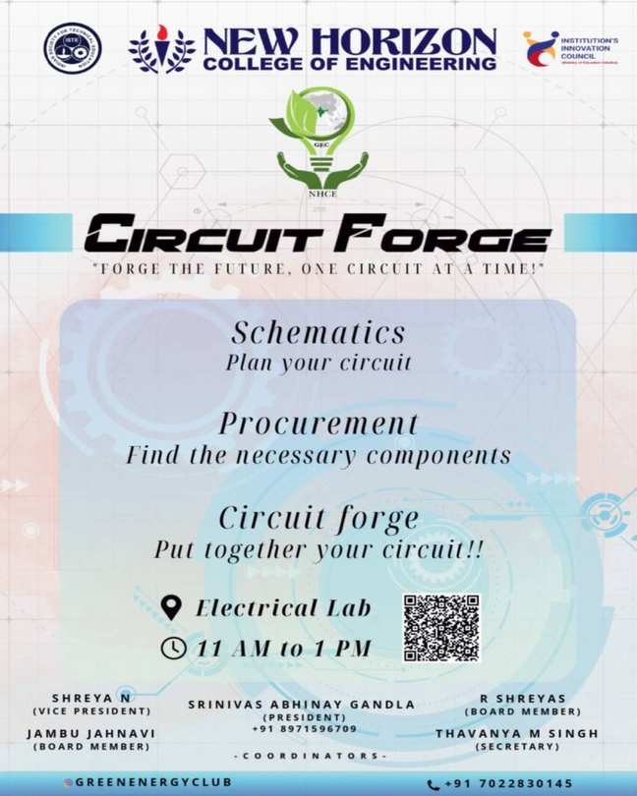
Green Energy Club
Circuit Forge
Overview: Circuit Forge tests quick circuit building and troubleshooting skills.
Activities: Solve circuit puzzles and practical challenges.
Objective: Focus on problem-solving and innovative circuit design.
Highlight: Fast-paced platform for engineers to showcase skills and creativity.
17

Slide 16
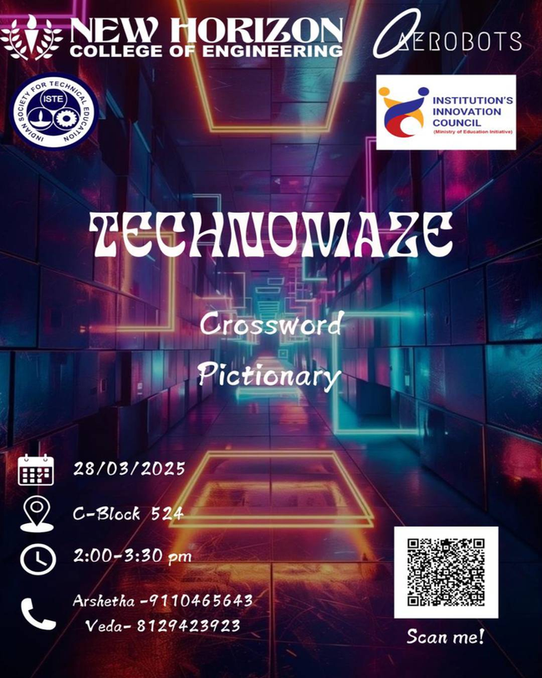
Aerobots Club
Technomaze
Overview: Technomaze tests logical and technical skills at NHCE.
Round 1 – Crossword: Participants solve word puzzles using given clues.
Round 2 – Pictionary: Players draw clues for others to guess.
Prizes: Top two winners get prize money; open to college students only.
18

Slide 17
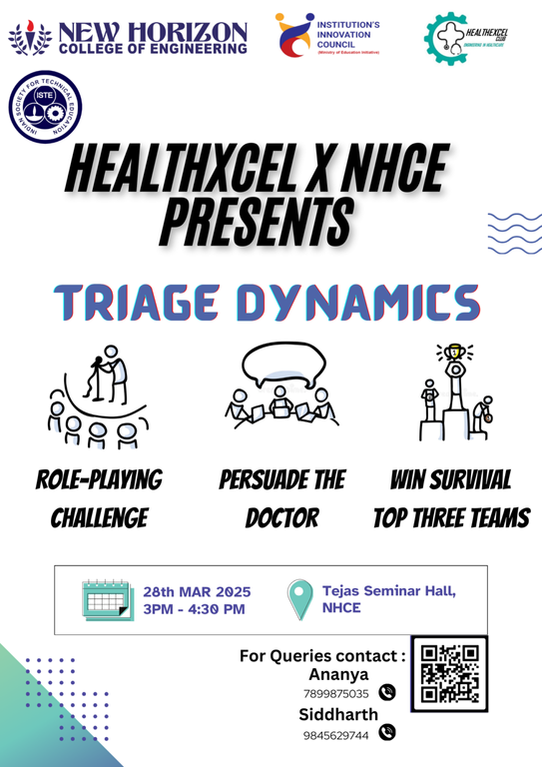
Healthxcel Club
Triage Dynamics
Overview: Triage Dynamic simulates a medical crisis through role-play by HealthXcel Club.
Objective: Show persuasion, empathy, and improvisation to convince the judge of urgent cases.
Challenge: Navigate a resource-limited scenario as characters with different medical conditions.
Outcome: Top three who best justify care needs win, highlighting critical thinking and communication.
19

Slide 18
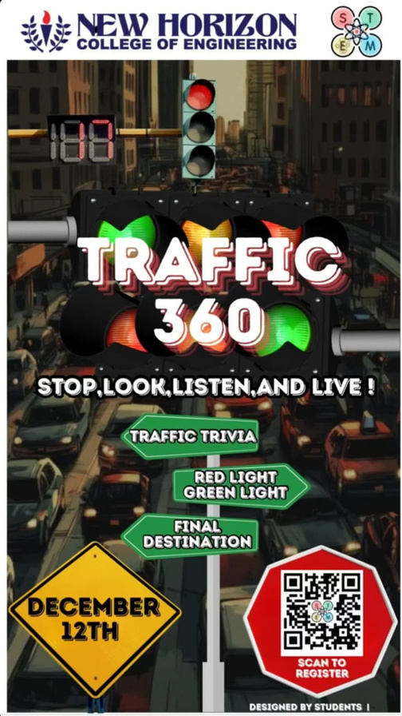
Stem Club
Traffic 360
Objective: Promote traffic rule awareness and teamwork through engaging activities.
The event had three rounds — Traffic Trivia, Red Light Green Light, and Final Destination — testing knowledge, coordination, and communication.
Participation: Teams of two showcased traffic knowledge and problem-solving skills.
Outcome: The event promoted road safety awareness and teamwork through fun learning.
20

Slide 19
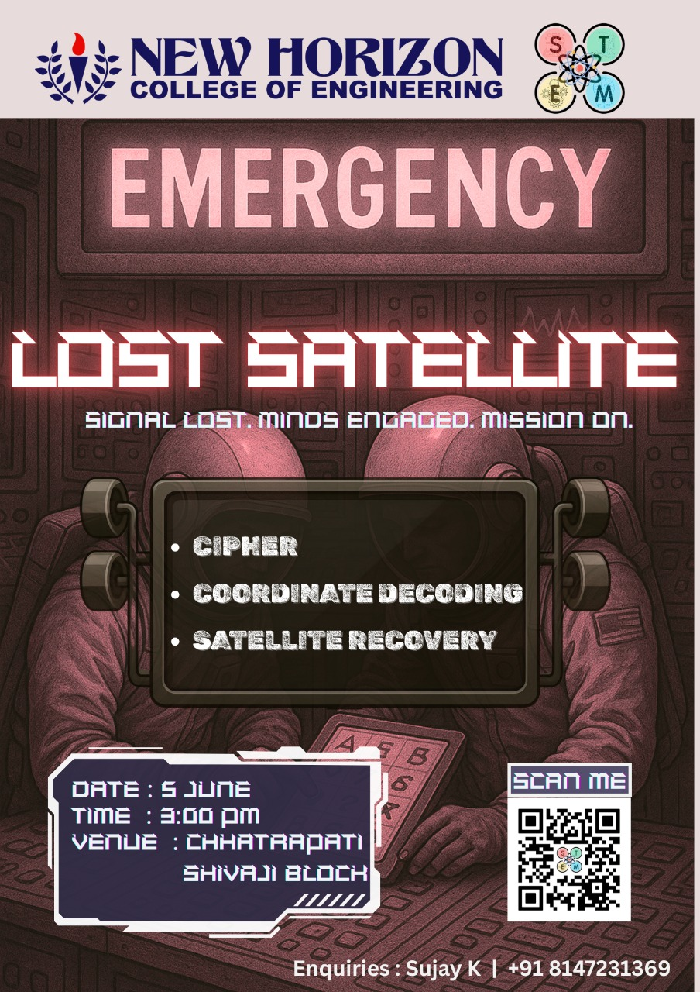
Stem Club
Synapse 25′ Event 1-Lost Satellite
Event Overview: “Lost Satellite: Decode the Signal” was a team-based challenge simulating a space crisis to recover the malfunctioning VAYU-1 satellite.
Tasks: Participants decoded ciphers, interpreted orbital data, analyzed Morse code, and traced satellite issues using technical clues.
Final Challenge: Teams presented recovery reports proposing solutions, highlighting structured problem-solving and real-time decision-making.
Outcome: The event blended space science, signal processing, and teamwork, enhancing technical skills and understanding of satellite operations.
21

Slide 20

FOSS Club
TRITECHX
Overview: TRITECHX was a thrilling tech event by the FOSS Club, packed with innovation, logic, and rapid development challenges.
Rounds: Featured SnippetStorm (coding & debugging) and Prompt & Deploy (AI-powered web solutions).
Highlights: Showcased creativity, technical skills, and real-world AI applications; appreciation to all participants, winners, and volunteers.
23

Slide 21
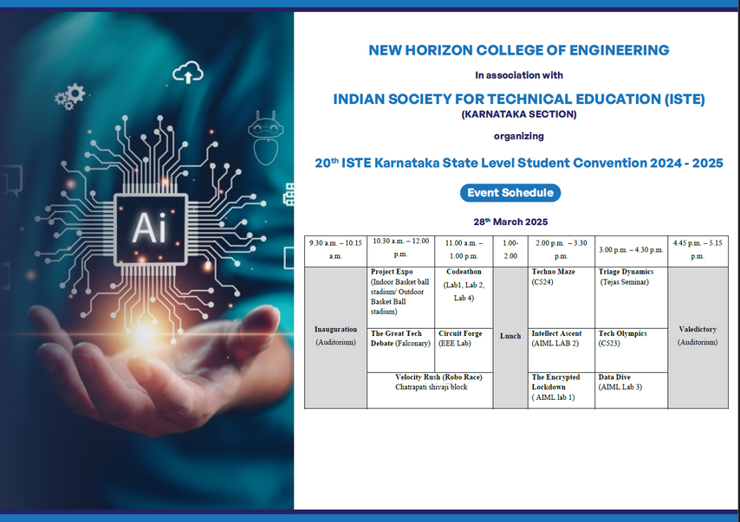
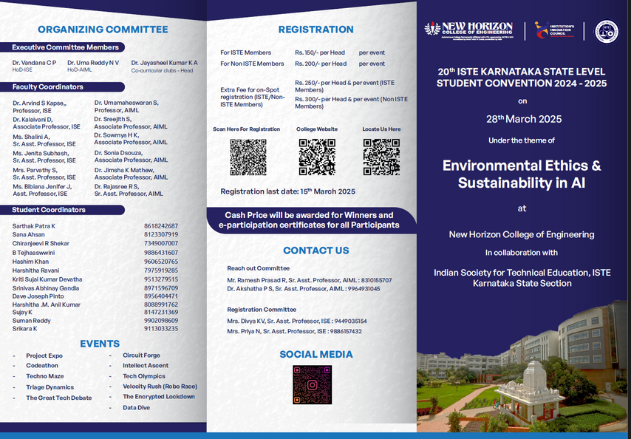
ISTE - Indian Society for Technical Education
24

Slide 22
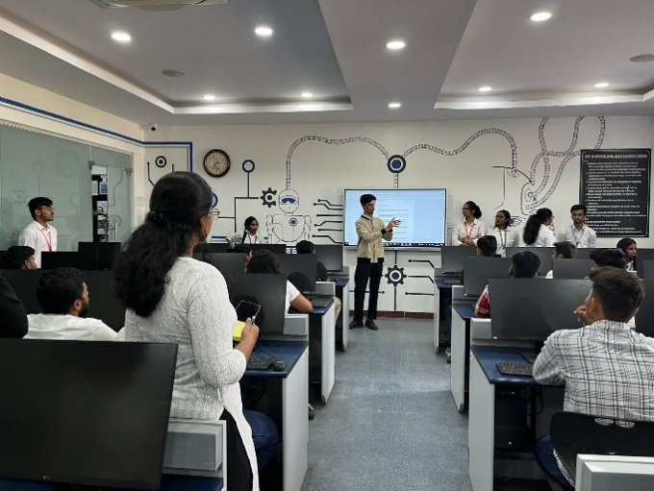
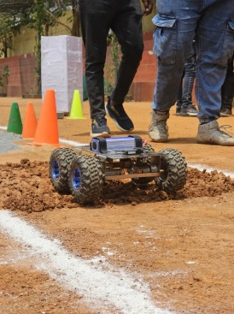
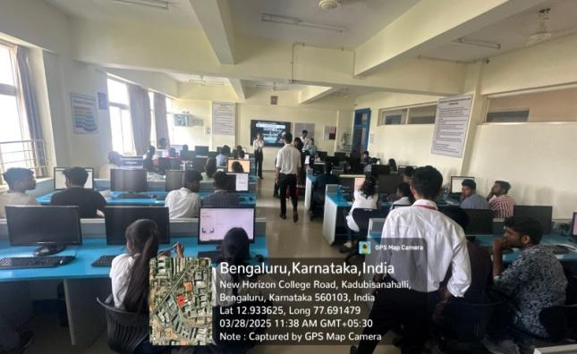
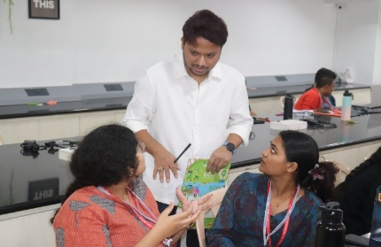
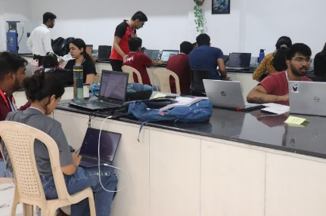
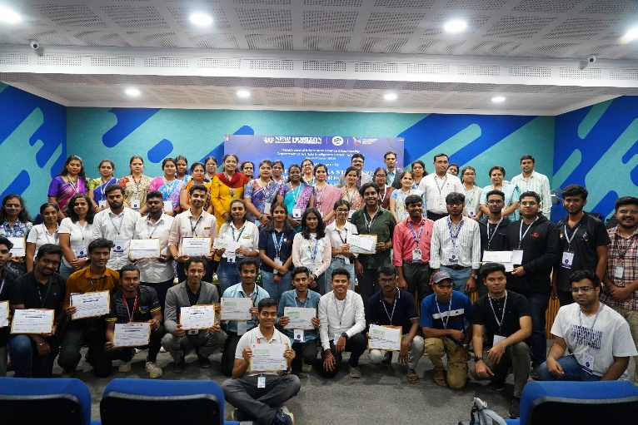
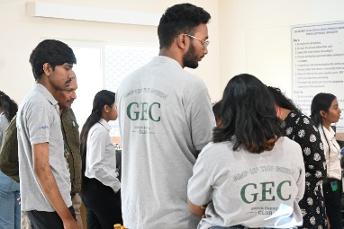
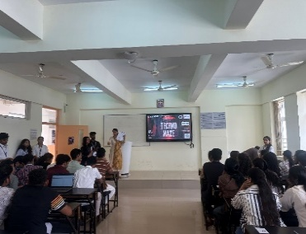
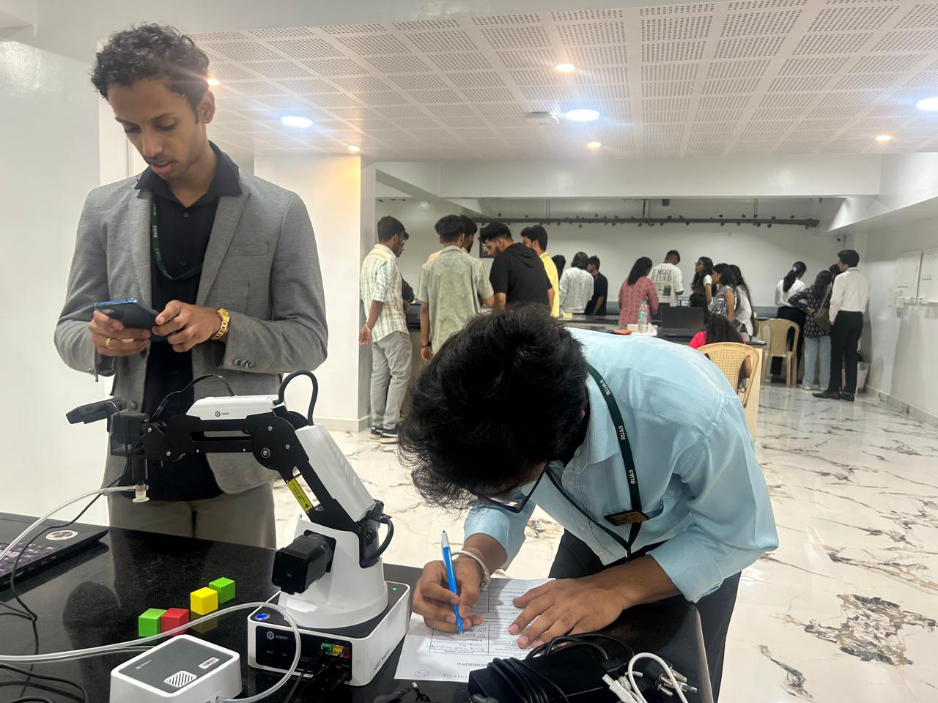
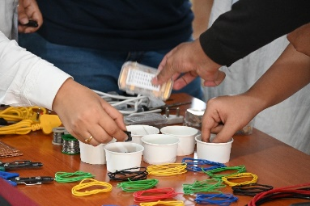
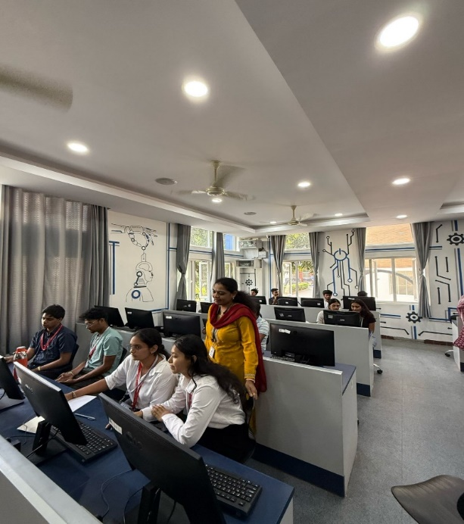
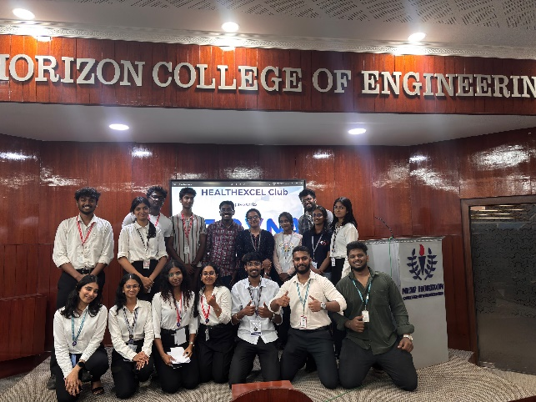
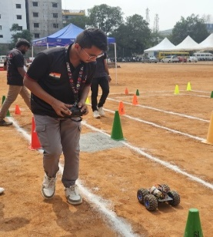
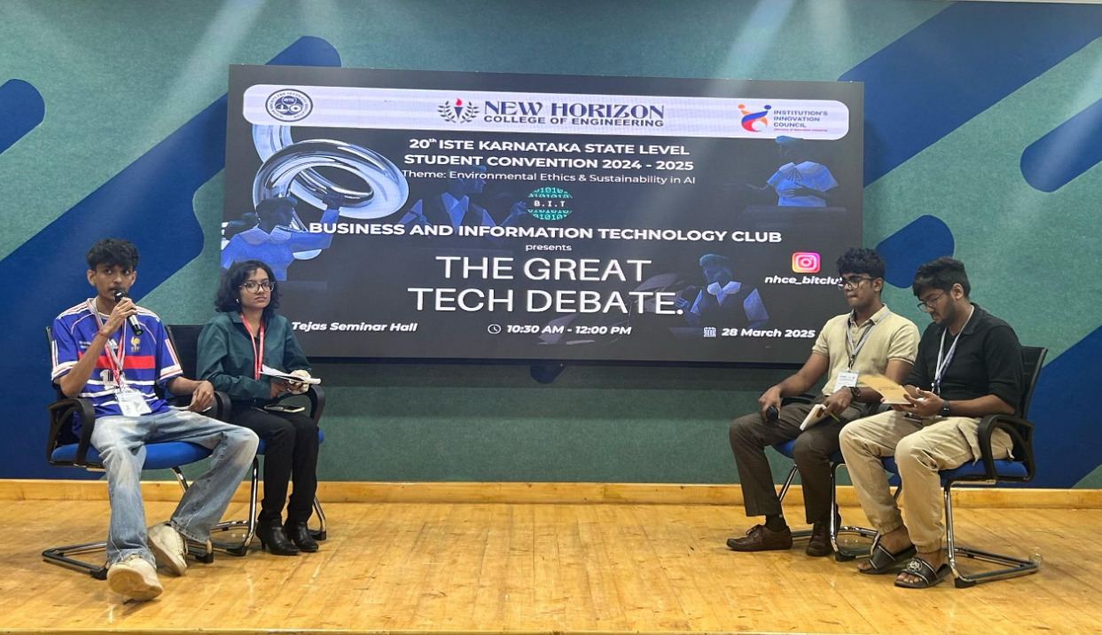
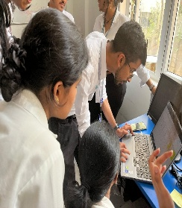
Glimpses of ISTE
24

Slide 23
Achievements
SL.NO | NAME |  |  | USN |  | BRANCH | NAME OF THE EVENT |  |  | WINNER/PARTICIPATED |  |  | PRIZE DETAILS
1 | Aditya Kumar |  |  | 1NH23CD194 |  | CDS | Code Breaker Challenge 1.0 |  |  | 2nd Runner Up |  |  | 10,000
2 | Akash Kumar Gupta |  |  | 1NH23CD008 |  | CDS
3 | Nithya Yadunatha |  |  | 1NH23CD108 |  | CDS
4 | Noble Tamrakar |  |  | 1NH23CD198 |  | CDS
5 | Aditya Kumar |  |  | 1NH23CD194 |  | CDS | Tech Avishkar - 2.0 |  |  | Participated |  |  | N/A
6 | Akash Kumar Gupta |  |  | 1NH23CD008 |  | CDS
7 | Nithya Yadunatha |  |  | 1NH23CD108 |  | CDS
8 | Noble Tamrakar |  |  | 1NH23CD198 |  | CDS
26

Slide 24
Achievements
SL.NO | NAME |  |  | USN |  |  | NAME OF THE EVENT |  |  |  | WINNER/PARTICIPATED |  |  | PRIZE DETAILS
1 | S Harsha Bhat |  |  | 1NH22IS139 |  |  | KJSSE CTF 2.O |  |  |  | Participated |  |  | N/A
2 | Srikara K |  |  | 1NH22CD107
3 | S Harsha Bhat |  |  | 1NH22IS139 |  |  | HACKATHENA’25 |  |  |  | Winners |  |  | 10,000
4 | Srikara K |  |  | 1NH22CD107
5 | Keerthan Poovaiah M M |  |  | 1NH22CD048
6 | G Shreyas Shetty |  |  | 1NH22CD030
7 | S Harsha Bhat |  |  | 1NH22IS139 |  |  | TECHSPRINT-48 |  |  |  | Top 10 |  |  | Goodies
8 | Srikara K |  |  | 1NH22CD107
9 | Keerthan Poovaiah M M |  |  | 1NH22CD048
10 | G Shreyas Shetty |  |  | 1NH22CD030
11 | S Harsha Bhat |  |  | 1NH22IS139 |  |  | Data Heist |  |  |  | Participated |  |  | N/A
12 | Srikara K |  |  | 1NH22CD107
27

Slide 25
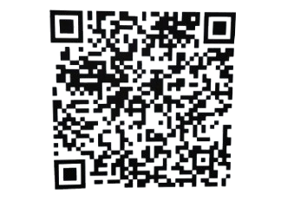

Connect with Us
https://newhorizoncollegeofengineering.in/students-clubs-info/
28

Slide 26
THANK YOU!

